Slide 1
Day 1
Machine Learning Module

Slide 2
Relation between PA and ML
What is Machine learning
Clustering Basics
Custer Applications
Clustering Validation
K-means clustering algorithm

Slide 3




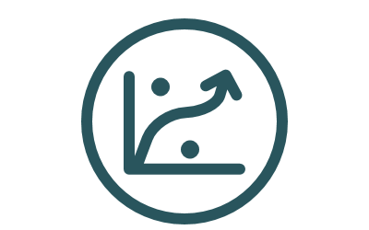

What is Predictive Analytics ?
Prescriptive
Prescriptive
Descriptive
Based on our findings, what decisions we can make?
Clean , relate, summarize, and visualize.
Tools: SQL, Python, Excel etc
Predictive
Analytics
Descriptive
Predative
Diagnostic
What will happen? Involves Building intelligent Models, evaluate and refine.
Discover data mining, drill down, causation, correlation
Tools: R, Python, etc.
Diagnostic
Predictive analytics is the practice of extracting insights from the existing data using some statistical modeling and machine learning.

Slide 4




Process life cycle
It is very important to have a predefine goal at this stage.
Define Objectives
It includes 1) collecting the right data, 2) preprocess them, 3) clean them, and most importantly set the depended and independent variables.
Data Preparation
Predictive Analytics
Assumes data is in good shape, selecting and building a model is a crucial step. It requires deep understanding of the data, objectives and the capability of chosen models
Modeling
Deploying a trained model requires validation before send it to action. At this stage a careful evaluation is required to understand the causes that might influence the model responses.
Monitor Model
Refinement
The above two step usually repeat many times and re-evaluation is done at this stage.

Slide 5



Predictive Analytics Components
Usually predictive analytics applications consider three fundamental components:
Assumptions
data
Predictive Analytics
The conclusions are usually assuming the future will follow patterns related to the past!
Data quality is a crucial requirement for predictive analytics. Every predictive model is strongly depending on the quality of the historical data it processes.
Includes the various statistical and ML techniques ranging from basic to complex methods.
modeling

Slide 6
Scope of Predictive Analytics
PA is conceptually adopts various techniques (from statistical, and AI.), machine learning can be thought of as set of tools used in predictive analytics stage.
Predictive analytics motivated strictly on a “cause”, and refreshed with “change” in data.
Machine Learning
GMM
Regression
reinforcement Learning
Predictive
HMM
Artificial Intelligence
Statistical Learning
Etc.

Slide 7
What is Machine learning
Machine learning is a computational learning approach involved in most artificial intelligence (AI) applications.
Systems or algorithms improve themselves through data experience without relying on explicit programming.
It is considered as modern-day extension of predictive analytics.
Many companies today depend on ML algorithms to better understand their data (from: clients, employees, systems, etc.)

Slide 8
Conceptual Picture of ML
Traditional Programming
Machine Learning
Data
Computer
Unseen
Output
Program
Data
Computer
Program
Output
Source: https://courses.cs.washington.edu/courses/csep573/11wi/lectures/19-mlintro.pdf Dr. Pedro Domingos

Slide 9
Common Factors
ML algorithms tend to have these three components:
Representation:
Evaluation:
Optimization
What are the characteristics of the problem?
What ML algorithms should I use?
What are the most important hyperparameters to tune?
How to evaluate the performance of the model?
Does accuracy of my predictions enough?
What captures the model’s errors?
What kind of optimization the selected algorithm uses?

Slide 10
Representation
Regressions
E.g. Simple Linear regression
Continuous outputs
Discriminative (Classification)
E.g. SVM
Discrete outputs
Grouping (Clustering)
E.g. K-means
Categories

Slide 11
Evaluation
Accuracy
Precision and recall
ROC curve, / AUC
F1-score
Within Squared Errors
Sensitivity/Specificity
Jaccard index
Etc.

Slide 12
Optimization
Combinatorial optimization
E.g.: Greedy search
Convex optimization
E.g.: Gradient descent
Constrained optimization
E.g.: Linear programming

Slide 13
Types of Learning
There are three types of Learing that will be covered in this module:
Unsupervised learning
The data does not include desired outputs
Supervised (inductive) learning
The data includes desired outputs
Semi-supervised learning
The data includes a few desired outputs

Slide 14
Unsupervised Learning
Clustering Basics

Slide 15
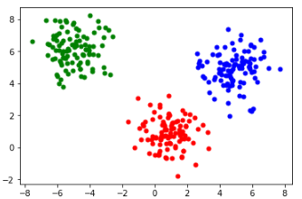
What is clustering?
Clustering is a technique used to group elements in a multivariate data sets.
Elements in each group share two main properties
They are similar to each other (i.e., related )
They are different to elements in other groups (i.e., unrelated)

Slide 16
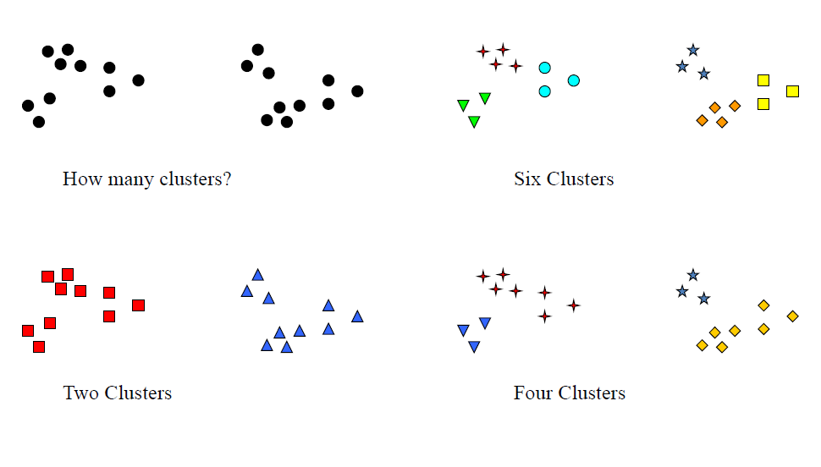
Data might be unclear

Slide 17
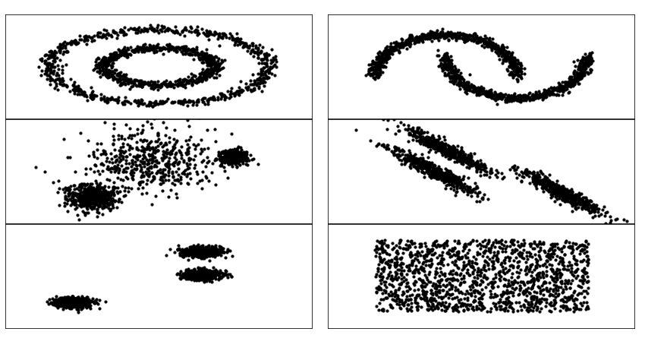
Different shapes of data

Slide 18
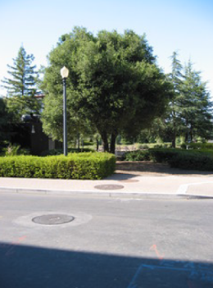
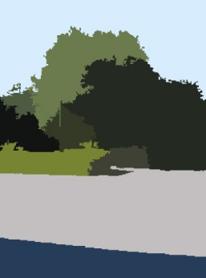
Why we need to perform clustering?
There are many reasons why we need to perform clustering on data sets. For example
A preprocessing step such as segmentation
Image segmentation
Salt Boundary Detection in seismic data [2]
Or market segmentation
Clustering
Source: https://commons.wikimedia.org/wiki/File:Image-segmentation-example-segmented.png

Slide 19
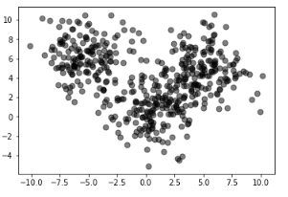
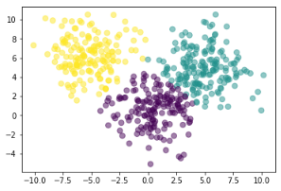
Why we need to perform clustering?
There are many reasons why we need to perform clustering on data sets. For example
Doing data exploration and understand data structure
e.g., Facies classification applied to a pre-salt carbonate reservoirs using K-means.
Results identified three seismic facies [1]
Illustration using python

Slide 20
Why we need to perform clustering?
There are many reasons why we need to perform clustering on data sets. For example
A preprocessing step such as segmentation
Multi-attribute K-means Cluster Analysis for Salt Boundary Detection [2]
Image segmentation
Or market segmentation
Doing data exploration and understand data structure
e.g., Facies classification applied to a pre-salt carbonate reservoirs using K-means. Results identified three seismic facies [1]
Pattern recognition:
Identify features or spatial data relationships
Outlier detection
Clustering is also used in outlier detection applications such as detection of credit card fraud.
etc.
In general, it is used to estimate the structure of the unlabeled data!

Slide 21

Scikit Learn
Scikit learn is machine learning library for Python
It supports many algorithms for clustering, classification, and regression problems.
It is adequately integrated with Numpy and Scipy
There are many functions that we’ll use during this week, and they will be introduced during our discussions.
Still under active development, latest release was in May 2019.

Slide 22
Generate/load datasets
Scikit learn has a package called datasets with great features
Generate controlled datasets (from scratch)
Load predefined datasets (reasonable size)
Fetch datasets (of large size )
Let’s focus on generate a dataset for now
To generate 3 clusters using make_blobs function is as follows.

Slide 23
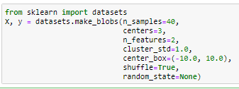
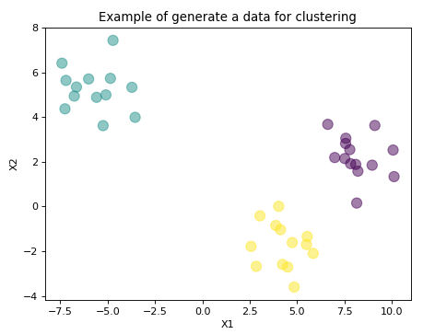
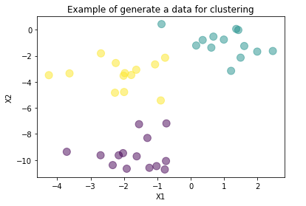
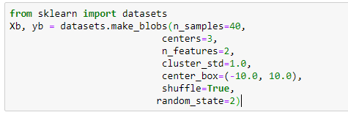
make_blobs
EX1

Slide 24
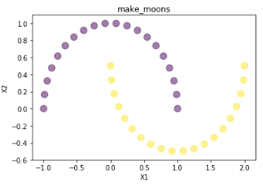
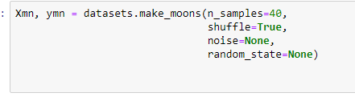
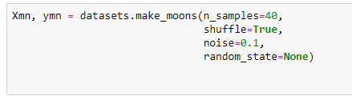
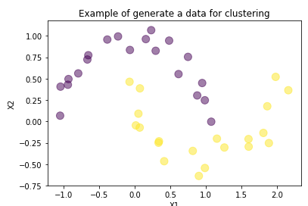
make_moon
EX1

Slide 25
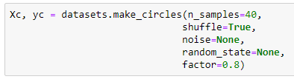
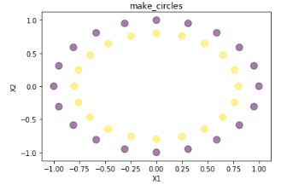
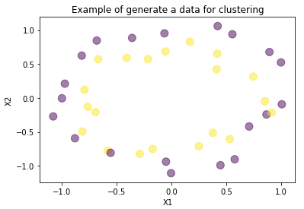
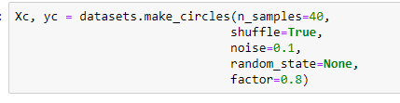
make_circles.
EX 1

Slide 26
Important aspects
Clustering capabilities
Geometric Measurements
Cluster validation

Slide 27
Clustering capabilities
Before clustering ( labeling your data), it is important to understand the following about your selected clustering algorithm
Scalability
Ability to discover clusters with attribute shape
How the performance in higher dimensionality
Identify outlier

Slide 28

Geometric Measurements
Clustering expects an input of the following form
Clustering algorithms use either
Similarity, or
Dis-similarity measurements
variables
$$\left[\begin{matrix}x_{11 } & ⋯ & x_{0,m} \\ ⋮ & ⋱ & ⋮ \\ x_{n,1} & ⋯ & x_{n, m }\end{matrix}\right]$$
Samples

Slide 29
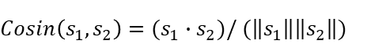
Measurements: Similarity
Similarity
Numerical measure of how similar are two data elements
Score ≈ 1 when elements are more alike
Score range [0,1]
Examples:
Cosine Similarity

Slide 30
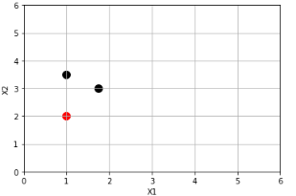
Example
Suppose we have three points
P₁=[1, 2],
P₂=[1.75, 3],
P₃=[1, 3.5]
Which of the two points P2, P3 is more similar to P1?
P₃
P₂
P₁

Slide 31


Measurements: Dissimilarity
Dis-similarity
Numerical measure of how different are two data elements
Score ≈ 0 when elements are more alike
Score range [0,∞ ⁡)
Examples:
Euclidean Distance
Minkowski Distance
Mahalanobis Distance

Slide 32

Example
EX2
Suppose we have three points
P₁=[1, 2], P₂=[1.75, 3], P₃=[1, 3.5]
Compute Euclidean distances from P1 to P2 and P3?
Compute Cityblock distances from P1 to P2 and P3?
use euclidean_distances( ) and manhattan_distances( )
Results:
Euclidean: E(P1, P2) = 1.25, E(P1, P3) = 1.5
Cityblock: Mink(P1, P2, 1) = 1.75, Mink(P1, P3, 1) = 1.5

Slide 33
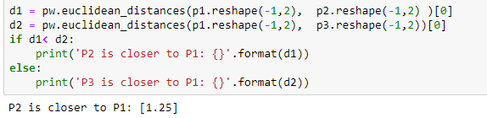
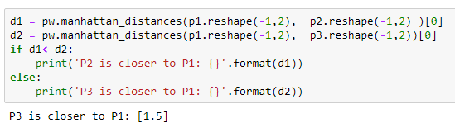
Contd.

Slide 34
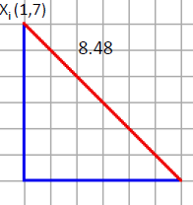
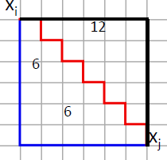
Differences in outcomes
Euclidean
City-block
P₃
0.5
P₂
1
0.75
P₁

Slide 35
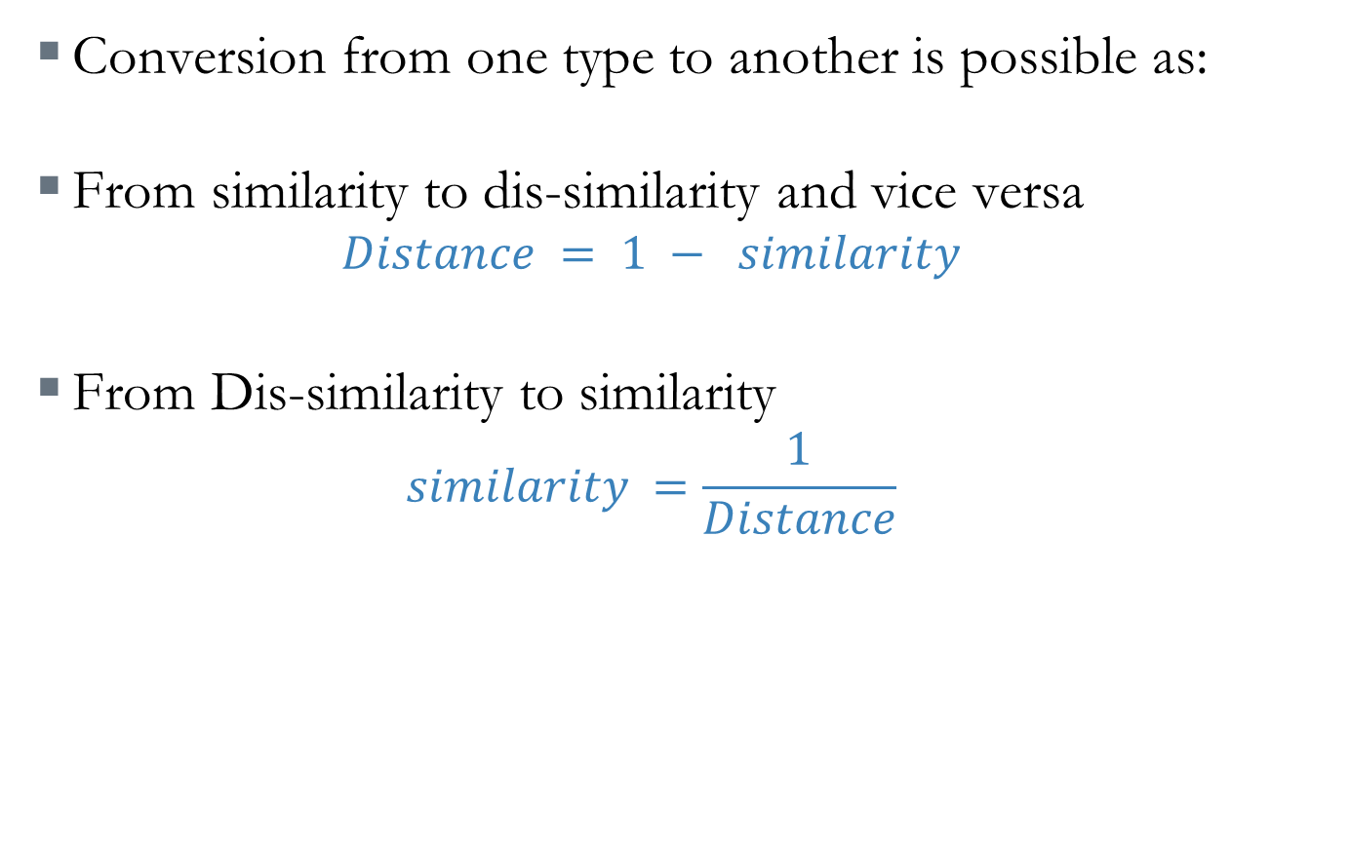
Measurement Conversion
Conversion from one type to another is possible as:
From similarity to dis-similarity and vice versa
$$Distance = 1 − similarity$$
From Dis-similarity to similarity
$$similarity =\frac{1}{Distance}$$

Slide 36


Standardization
Standardization (Normalization) is the process of rescaling the values of variables in your data to share a common scale. Common examples
Min-max
Z-score
$$s=\frac{diff}{range}$$

Slide 37
Clustering Validation
Why we need to evaluate?
Compare clustering algorithms
Increase confidence in the clustering results
A good clustering will produce high quality clusters
The intra-class similarity is high
The inter-class similarity is low
The quality depends on the similarity metrics used
There are two clustering evaluation methods:
Comparing the clustering results to a ground truth (External Index)
If GT is not available use (Internal Index).

Slide 38
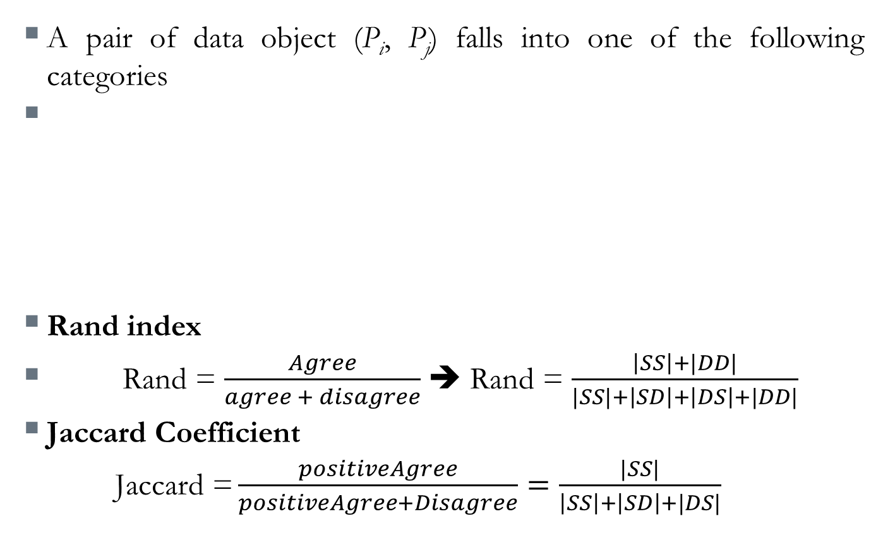
External Index: Rand Index and Jaccard Coefficient
A pair of data object (P_{i}, P_{j}) falls into one of the following categories
Rand index
Rand = $\frac{Agree}{agree + disagree}$ ➔ Rand = $\frac{\left|SS\right|+|DD|}{|SS|+\left|SD\right|+\left|DS\right|+|DD|}$
Jaccard Coefficient
$\text{Jaccard} \text{=}\frac{positiveAgree}{positiveAgree+Disagree}=\frac{|SS|}{\left|SS\right|+\left|SD\right|+|DS|}$
 | GT | Result | Type
SS | 1 | 1 | Agree
DD | 0 | 0 | Agree
SD | 1 | 0 | Disagree
DS | 0 | 1 | Disagree

Slide 39
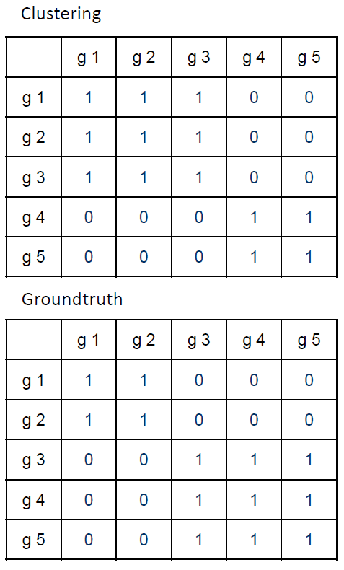
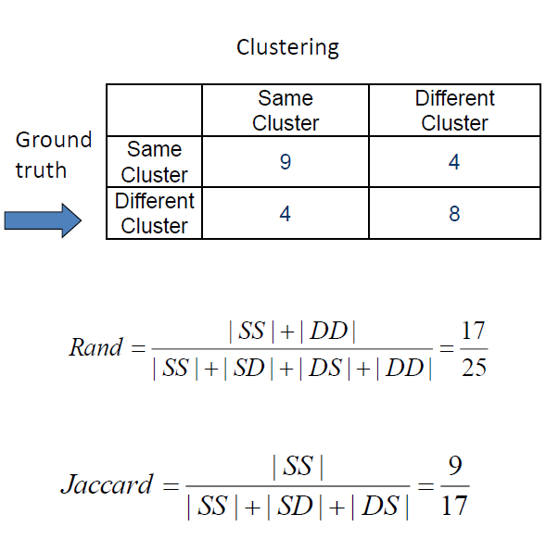
Example ( External Index)

Slide 40

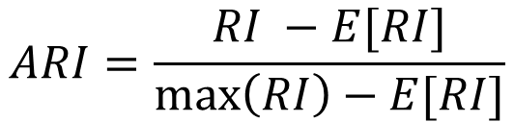
From Scikit-learn
EX3
Scikit-learn provides both metrics, however, Rand index is adjusted.
ARI has range of [-1, 1], the positive index means good clustering, perfect is 1.
$$ARI=\frac{RI −E[RI]}{\max\left(RI\right)−E[RI]}$$
or

Slide 41
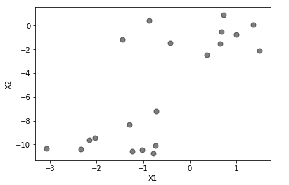
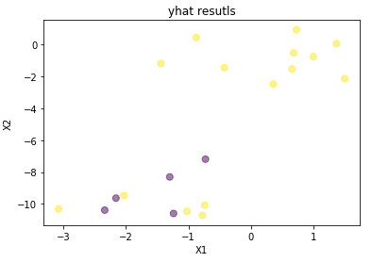
Results
Rand: 0.219 ( 22%)
Jaccard: 0.66 (66%)
Jaccard Similarity: 0.75 (75%)
With the above results, Jaccard tells that we got 66%-75% hits. This means if we are in a two cluster setting, about 25% of datapoints in the other cluster are not labeled correctly. Similarly, Rand is positive which indicates accepted cluster, but many misses in the second cluster.

Slide 42


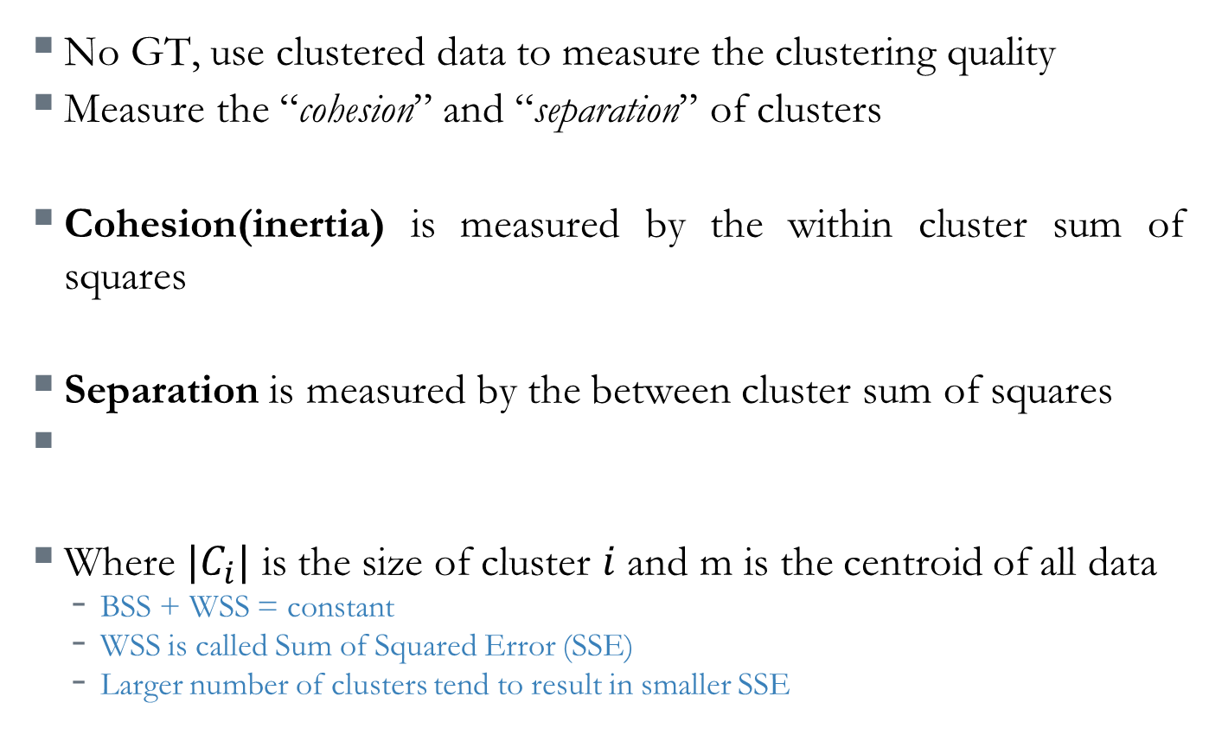
Internal Index: cohesion & separation
No GT, use clustered data to measure the clustering quality
Measure the “cohesion” and “separation” of clusters
Cohesion(inertia) is measured by the within cluster sum of squares
Separation is measured by the between cluster sum of squares
Where $|C_{i}|$ is the size of cluster $i$ and m is the centroid of all data
BSS + WSS = constant
WSS is called Sum of Squared Error (SSE)
Larger number of clusters tend to result in smaller SSE

Slide 43
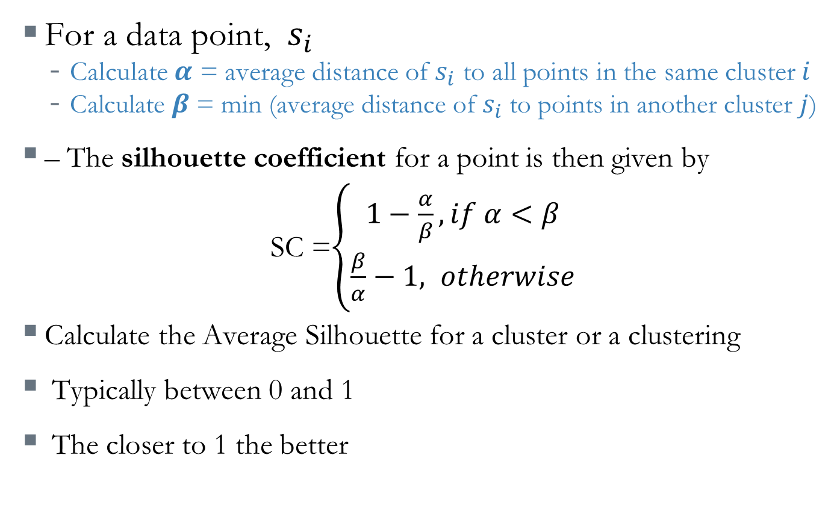
Internal Index: Silhouette Coefficient
For a data point, $s_{i}$
Calculate $α$ = average distance of $s_{i}$ to all points in the same cluster $i$
Calculate $β$ = min (average distance of $s_{i}$ to points in another cluster $j$)
– The silhouette coefficient for a point is then given by
SC =$\left\{\begin{aligned}1−\frac{α}{β}, if α<β \\ \frac{β}{α}−1, otherwise\end{aligned}\right.$
Calculate the Average Silhouette for a cluster or a clustering
Typically between 0 and 1
The closer to 1 the better

Slide 44
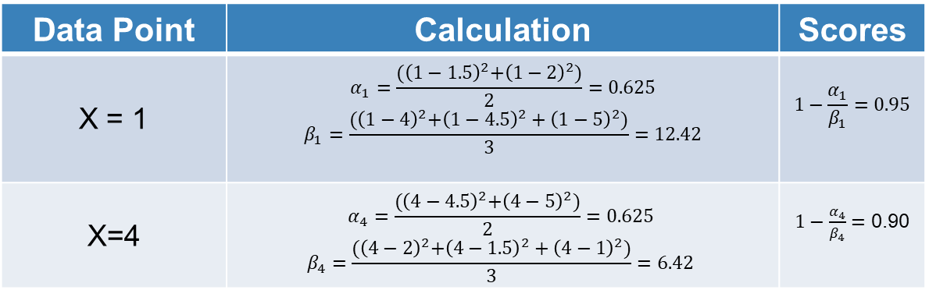
Example ( Internal Index)
m₁
m₂
1
2
3
4
5
Data Point | Calculation | Scores
X = 1 | $$α_{1}=\frac{{(\left(1−1.5\right)}^{2}+{\left(1−2\right)}^{2})}{2}=0.625$$ $$β_{1}=\frac{{(\left(1−4\right)}^{2}+{\left(1−4.5\right)}^{2}+{\left(1−5\right)}^{2})}{3}=12.42$$ | $$1−\frac{α_{1}}{β_{1}}=0.95$$
X=4 | $$α_{4}=\frac{{(\left(4−4.5\right)}^{2}+{\left(4−5\right)}^{2})}{2}=0.625$$ $$β_{4}=\frac{{(\left(4−2\right)}^{2}+{\left(4−1.5\right)}^{2}+{\left(4−1\right)}^{2})}{3}=6.42$$ | $1−\frac{α_{4}}{β_{4}}=$ 0.90

Slide 45
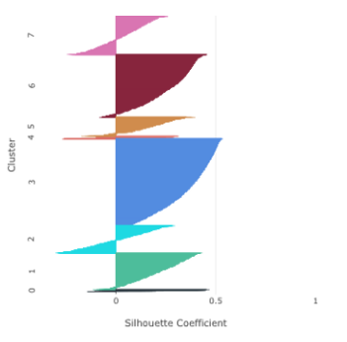
Silhouette per sample
These clusters
are well formed

Slide 46
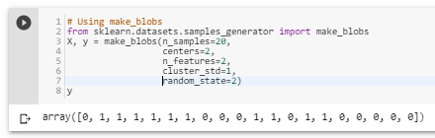
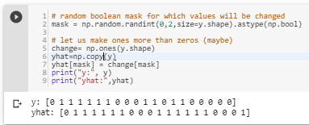

Example: Silhouette
EX4

Slide 47
Results
WSS: 338.0
BSS: 109.33
WSS(Cohesion), from the results our clustering is not good. We have bad cohesion and small separation between clusters. For good results the values must be the opposite

Slide 48
Unsupervised Learning
K-means Clustering

Slide 49
Introduction
The K-means algorithm by far is the most popular and widely used algorithm.
K-means clustering algorithm is a machine learning technique used to identify distinct patterns or structures within unlabeled data.
It is centroid-based (partition) algorithm
The variable K represents the number of groups in the data.

Slide 50
K-means clustering algorithm
Choose the number of clusters K
Specify the cluster seeds (Initial Centroids)
Assign each point to a centroid based on distance
Adjust the centroids coordinates
Repeat the last two steps until no centroid updates.

Slide 51
K-means Illustration (animi)
Source: https://towardsdatascience.com/the-5-clustering-algorithms-data-scientists-need-to-know-a36d136ef68

Slide 52
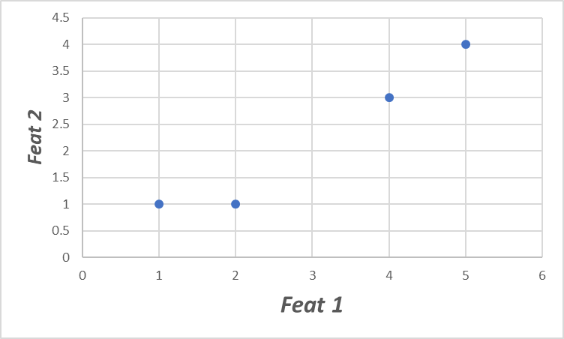
Quick Example
Suppose we have 4 samples and each has two features (Feat1, and Feat2). Our goal is to gather them into groups (K = 2).
Type | Feat1 | Feat 2
A | 1 | 1
B | 2 | 1
C | 4 | 3
D | 5 | 4

Slide 53


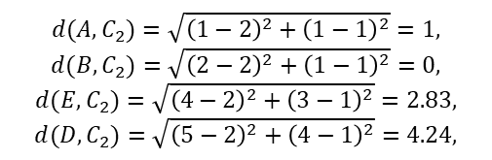

Example
Step 1: Select number of clusters: 2
Step 2: Initial seed points, let us select A, and B points
Step 3: Assign each point to a cluster with the nearest seed point
$$C_{1}=(1,1), C_{2}=(2, 1)$$
$${d(A,C}_{1})=\sqrt{{\left(1−1\right)}^{2}+{\left(1−1\right)}^{2}}=0,$$
$${d(B,C}_{1})=\sqrt{{\left(2−1\right)}^{2}+{\left(1−1\right)}^{2}}=1,$$
$${d(E,C}_{1})=\sqrt{{\left(4−1\right)}^{2}+{\left(3−1\right)}^{2}}=3.61,$$
$${d(D,C}_{1})=\sqrt{{\left(5−1\right)}^{2}+{\left(4−1\right)}^{2}}=5,$$
D
E
x
x
B
$${d(A,C}_{2})=\sqrt{{\left(1−2\right)}^{2}+{\left(1−1\right)}^{2}}=1,$$
$${d(B,C}_{2})=\sqrt{{\left(2−2\right)}^{2}+{\left(1−1\right)}^{2}}=0,$$
$${d(E,C}_{2})=\sqrt{{\left(4−2\right)}^{2}+{\left(3−1\right)}^{2}}=2.83,$$
$${d(D,C}_{2})=\sqrt{{\left(5−2\right)}^{2}+{\left(4−1\right)}^{2}}=4.24,$$
A
$$C_{1}⇒\left\{A\right\}, C_{2}⇒\{B, C, D\}$$

Slide 54

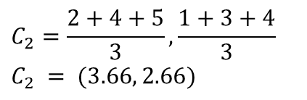
Example
Step 4: Adjust the centroids coordinates
Centroid:
No change!
$$C_{1}=\left(1,1\right),$$
x
D
E
$$C_{2}=\frac{2+4+5}{3},\frac{1+3+4}{3}$$
$$C_{2} = (3.66, 2.66)$$
x
x
Centroid:
A
B
End of Iteration 1, repeat! ( we have centroid change coordinates)

Slide 55


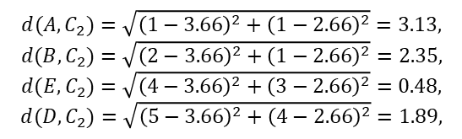

Example (Iteration 2)
Step 3: Assign each point to a cluster with the nearest seed point
$$C_{1}=(1,1), C_{2}=(3.66, 2.66)$$
$${d(A,C}_{1})=\sqrt{{\left(1−1\right)}^{2}+{\left(1−1\right)}^{2}}=0,$$
$${d(B,C}_{1})=\sqrt{{\left(2−1\right)}^{2}+{\left(1−1\right)}^{2}}=1,$$
$${d(E,C}_{1})=\sqrt{{\left(4−1\right)}^{2}+{\left(3−1\right)}^{2}}=3.61,$$
$${d(D,C}_{1})=\sqrt{{\left(5−1\right)}^{2}+{\left(4−1\right)}^{2}}=5,$$
x
D
E
x
$${d(A,C}_{2})=\sqrt{{\left(1−3.66\right)}^{2}+{\left(1−2.66\right)}^{2}}=3.13,$$
$${d(B,C}_{2})=\sqrt{{\left(2−3.66\right)}^{2}+{\left(1−2.66\right)}^{2}}=2.35,$$
$${d(E,C}_{2})=\sqrt{{\left(4−3.66\right)}^{2}+{\left(3−2.66\right)}^{2}}=0.48,$$
$${d(D,C}_{2})=\sqrt{{\left(5−3.66\right)}^{2}+{\left(4−2.66\right)}^{2}}=1.89,$$
A
B
$$C_{1}⇒\left\{A,B\right\}, C_{2}⇒\{C, D\}$$

Slide 56

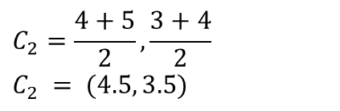
Example
Step 4: Adjust the centroids coordinates
x
Centroid:
$$C_{1}=\frac{1+2}{2},\frac{1+1}{2}$$
$$C_{1} = (1.5, 1)$$
x
D
E
x
x
Centroid:
$$C_{2}=\frac{4+5}{2},\frac{3+4}{2}$$
$$C_{2} = (4.5, 3.5)$$
A
B
End of Iteration 2, repeat! ( we have centroid change coordinates)
Iteration 3, Will introduce no change to clusters centroids, hence Convergence.

Slide 57


How K-means partitions?
start
Select (K)
Yes
Centroid
Change
no
$$Dist(x_{i} , C_{i})$$
End
Update $C_{i}$
Changing initial positions of centroids may lead to a new grouping (partitioning).

Slide 58



Scikit Learn - KMeans
Import KMeans class.
Initialize Kmeans and specify required parameters
Fit it to a training data

Slide 59
Kmeans Parameters and Attributes
EX
5

Slide 60



Results
2 clusters
4 clusters
3 clusters

Slide 61



How to select the number of Clusters
EX 6
Is there a criterion for selecting K ?
Yes, the widely adopted method is the so called Elbow-Method.
In K-means clustering, we minimize the inertia distances (WSS), and maximize the inter(BSS) distance(Simultaneously).
By using a repeated clustering with different number of clusters each time, observe the WSS behavior. It will look something like:

Slide 62

Silhouette selection of K value
EX 7
Silhouette is also useful to determine the best number of K clusters in a given data.
Silhouette tends to approach value of 1 when the cohesion of the clusters is high.
A good procedure is to repeat clustering of the data for several Ks. That is $k=\left\{2,3,4,5,6,…, n\right\}$
Then, pick the model with max silhouette coefficient

Slide 63
Results
Silhouette score( 2 clusters) =0.79
Silhouette score( 3 clusters) =0.63
Silhouette score( 4 clusters) =0.42
Therefore, we can use silhouette for selection of good K

Slide 64

Exercise 7 results

Slide 65

Kmeans Capabilities
EX 8
Data with different spread.
Was Kmeans successful?

Slide 66

Kmeans Capabilities
EX 8
Data with different densities.
Was Kmeans successful?

Slide 67

Kmeans Capabilities
EX 8
Skewed Datasets
Circles, and moons datasets

Slide 68
Pros & Cons
Pros
Simple to understand
Fast to cluster
Suitable for large datasets
Widely adopted
Easy to implement
Always yields a result ( deceiving sometimes)
Cons
Requires number of clusters as input
Sensitive to initialization
Lacks Consistency
Sensitivity to scale and outliers
Spherical clusters

Slide 69
Cons & Remedy
Cons
Requires number of clusters as input
Sensitive to initialization
Lacks Consistency
Sensitivity to scale and outliers
Spherical clusters
Possible Remedy
Elbow method
Multiple runs with different centroid seeds
Always remember to standardize data and get rid of single point clusters if occur twice

Slide 70
Thank you

Slide 71
References
Ferreira, D. J. A., Lupinacci, W. M., de Andrade Neves, I., Zambrini, J. P. R., Ferrari, A. L., Gamboa, L. A. P., & Azul, M. O. (2019). Unsupervised seismic facies classification applied to a presalt carbonate reservoir, Santos Basin, offshore Brazil. AAPG Bulletin, 103(4), 997-1012.‏ 10.1306/10261818055
Di, H., M. Shafiq, and G. AlRegib. "Multi-attribute k-means cluster analysis for salt boundary detection." 79th EAGE Conference and Exhibition 2017. 2017.‏

